Slide 1
Final Project Team Members Nader Christina Bala Antonio Beau

Slide 2
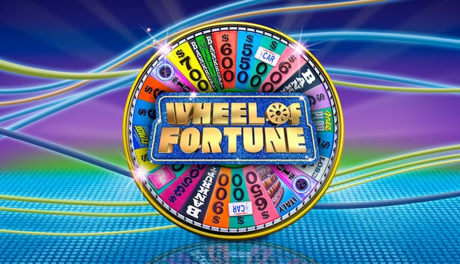

Slide 3

Implement a Software-As-A-Service ‘Wheel of Fortune Game’

Slide 4

Interactive game where the user plays against the computer
Computer develop intelligence by utilizing Machine Learning and AI

Slide 5
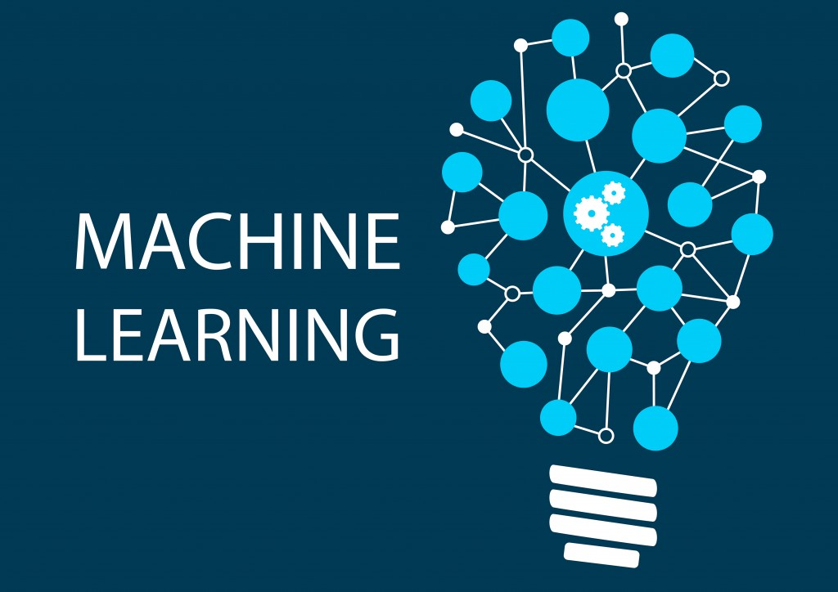



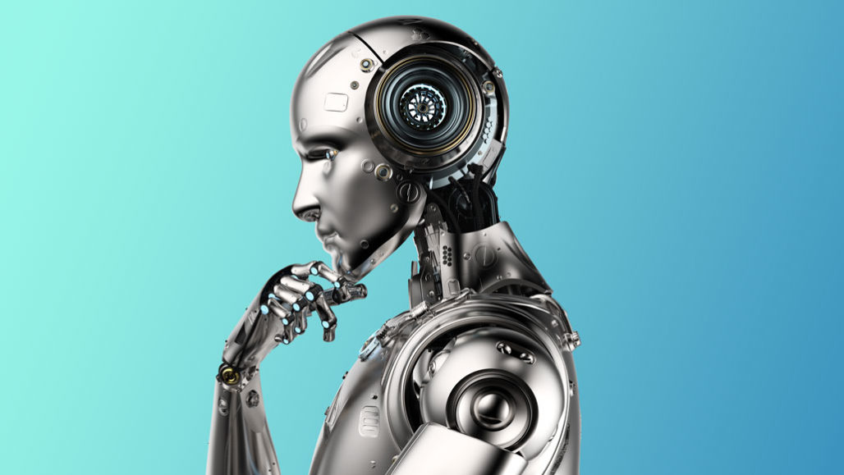






Technologies
We Used

Slide 6
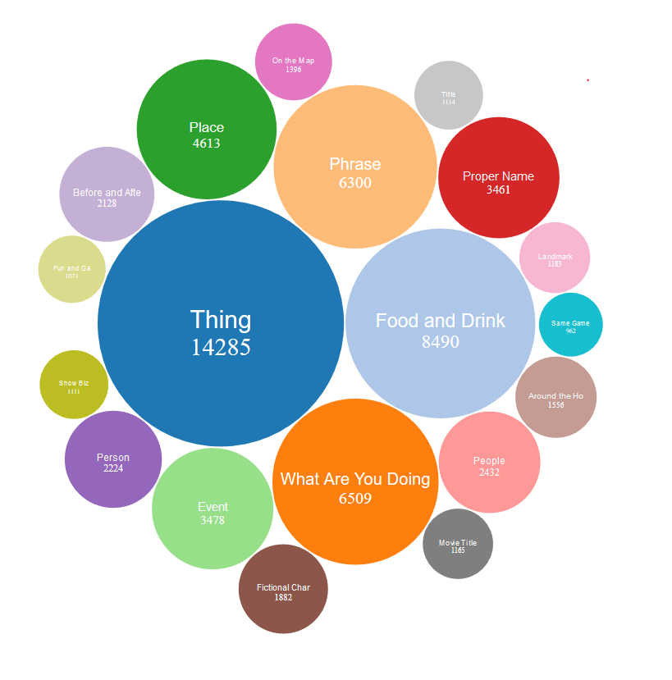

Slide 7
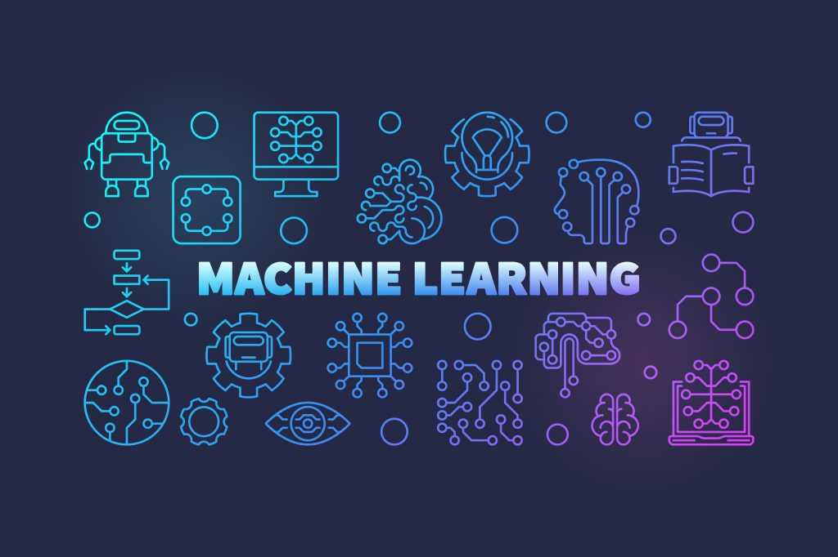

Slide 8
Rules of the Game:
One Game
Player vs Computer1 vs Computer2
Contestants compete to solve word puzzles
Contestants take turn spinning the wheel have option to guess a letter or solve the puzzles

Slide 9
Continue:
Vowel can be bought for 200 a piece
If contestant has no money than vowels cannot be bought
Wheel has $$ amount, ‘Lose a Turn’ & ‘Bankruptcy
Whoever solve the puzzle win the game and the prize amount

Slide 10


